Slide 1

ASIS&T Taipei Chapter Research Forum
Social Aspects of Reading
Behavior Research
NCCU
Graduate Institute of Library, Information and Archival Studies
Yung-Ting Chen pudding@nccu.edu.tw
Dec 7, 2016
Notes:
共用網址：https://docs.google.com/presentation/d/16FOjgA6PU72X8bjjlLGgVHR_I9AtnlPCaWvwdfgbJIU/edit?usp=sharing
短網址：http://l.pulipuli.info/16/asist
講稿：https://docs.google.com/document/d/1JcBrDpNCllpNOCl74-KJnGJG9NefxTx14Rh-WmoPG2g/edit?usp=sharing
社交閱讀行為研究

Slide 2



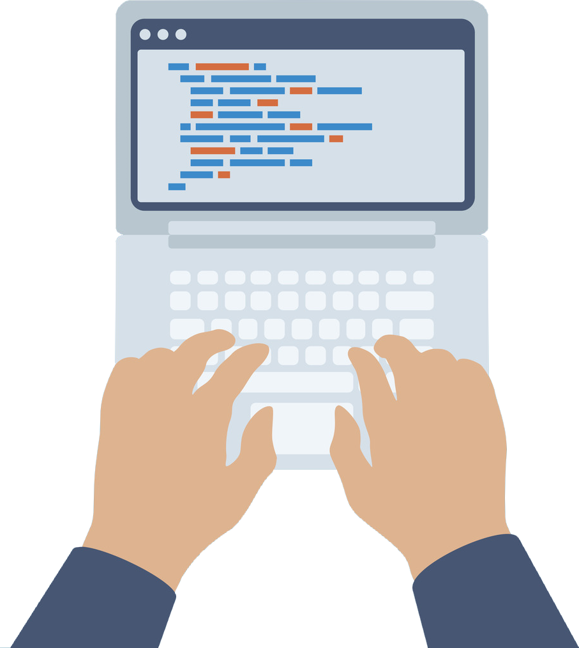
Yung-Ting Chen
National Chengchi University Ph.D Canididate of Library, Information and Archival Science
National Chengchi University Master of Library, Information and Archival Science, 2010
Fu Jen Catholic University Bachelor of Library and Information, 2005
Expertise and Skills
Digital Archive & Digital Library
Digital Learning
Programming
Notes:
IFLA投影片：https://docs.google.com/presentation/d/11EHBz9t18Vy_Umm6oZNORtAQgWXq_dpll-Id46OJg5o/edit#slide=id.p7
IFLA講稿：https://docs.google.com/document/d/10AiuC5lyROXVKDUmVorPHrBuzr7BQ446ON4Rfj5qZL8/edit
http://blog.pulipuli.info/p/about_38.html#cv_eng
I am a PhD student from National Cheng-chi University.
My research interest is e-learning and activity reading.
I am also found of programming.

Slide 3

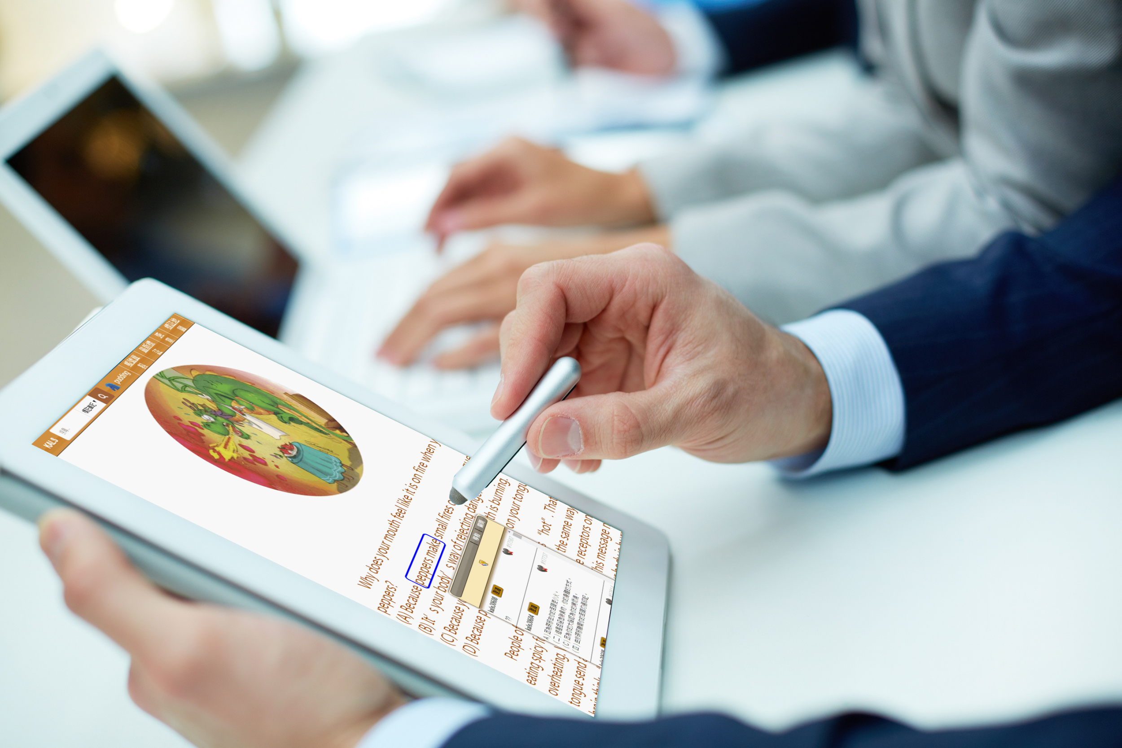
Digital Reading Environment
Notes:
20140120 合作式數位閱讀之標註路徑探勘 - public
https://docs.google.com/presentation/d/1LzobWZZTdeAeobTUsUd9gWroWUJvgpuhIeCxLRpZfK0/edit#slide=id.p23
Moodle的範例
http://exp-kals-moodle-2014.dlll.nccu.edu.tw/pluginfile.php/1676/mod_resource/content/0/exp_step2-4.html#select=36,37
圖片來源

Slide 4

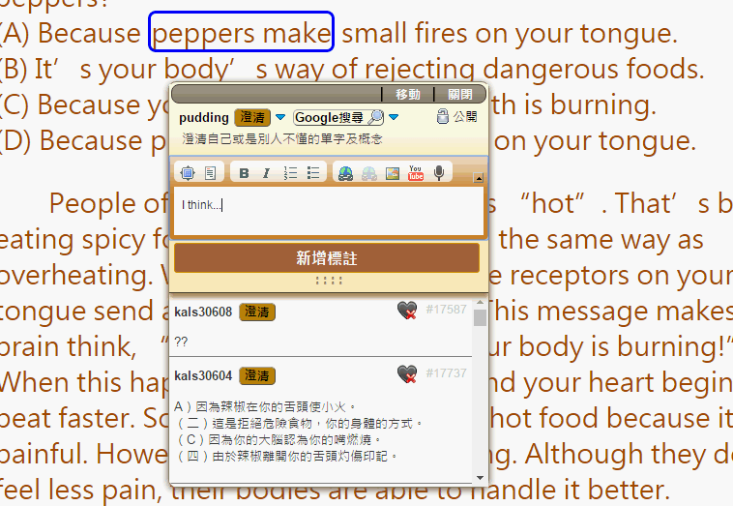


Social Reading with Annotation
Me
Classmate A
Classmate B
Notes:
20140120 合作式數位閱讀之標註路徑探勘 - public
https://docs.google.com/presentation/d/1LzobWZZTdeAeobTUsUd9gWroWUJvgpuhIeCxLRpZfK0/edit#slide=id.p23

Slide 5
Social Reading with Annotation
!$#%
^$&
$#%
Notes:
20140120 合作式數位閱讀之標註路徑探勘 - public
https://docs.google.com/presentation/d/1LzobWZZTdeAeobTUsUd9gWroWUJvgpuhIeCxLRpZfK0/edit#slide=id.p23

Slide 6
Social Aspects of Reading Behavior Research

Slide 7

Research Objective
Social Reading Environment & Performance Accessment
Social Reading Behavior Analysis
Using brain wave monitor to analyze reading behaviors

Slide 8
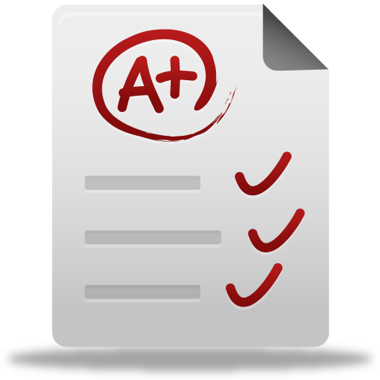

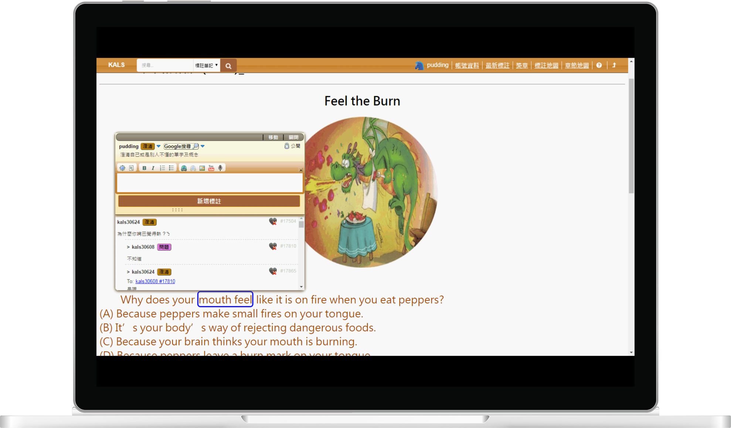

1. Social Reading Environment & Performance Accessment
Performance

Slide 9

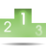
1. Social Reading Environment & Performance Accessment
Social Awareness
&
Gamify Reading
Performance

Slide 10
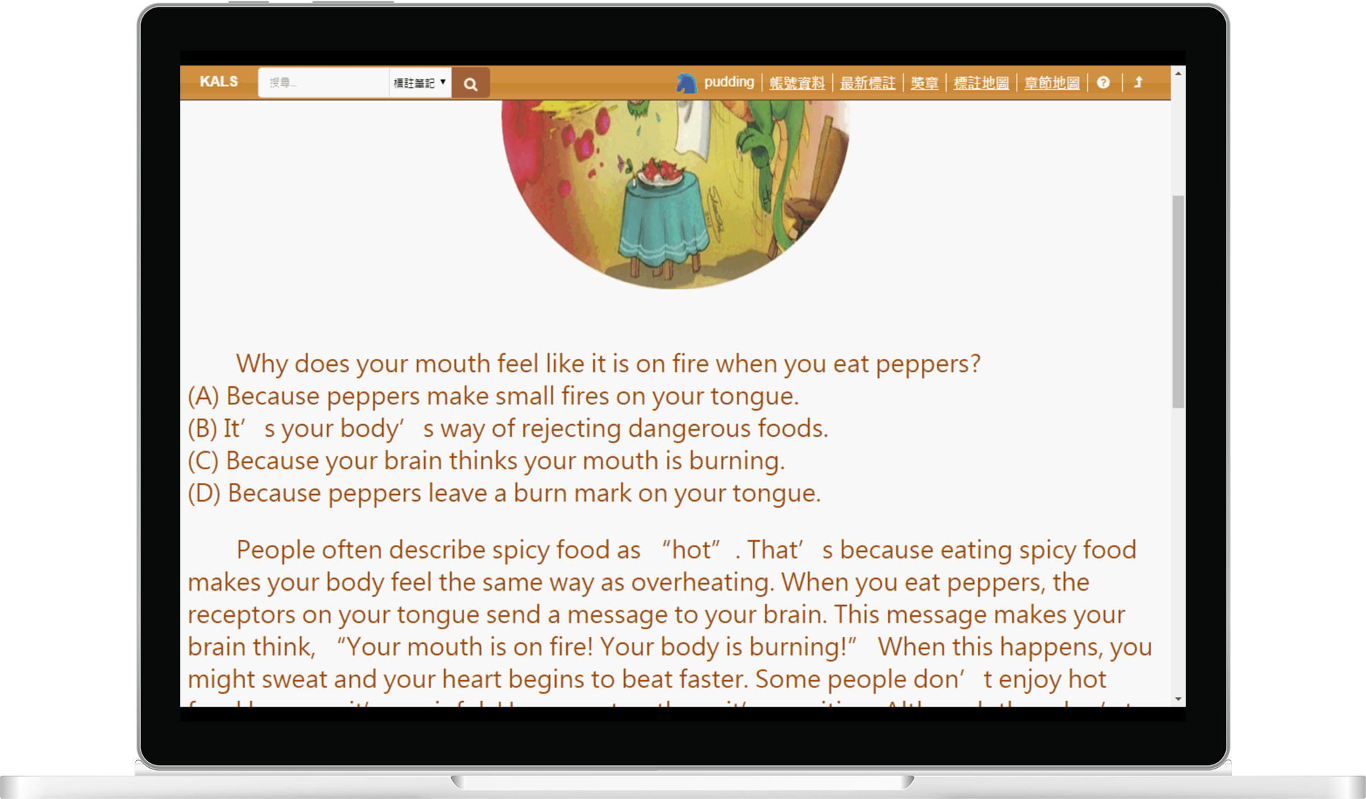
2. Social Reading Behavior Analysis
Personal
Group
1
2
3
4
5

Slide 11
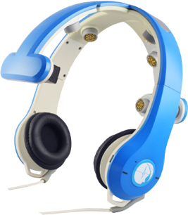
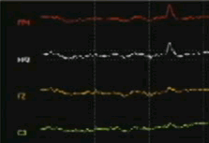
3. Using brain wave monitor to analyze reading behaviors
Brain Wave
Monitor
EEG
Learning alone
Socializing
$^&
#&%
Notes:
腦波儀

Slide 12
Thank you
for your attention
Notes:
IFLA投影片：https://docs.google.com/presentation/d/11EHBz9t18Vy_Umm6oZNORtAQgWXq_dpll-Id46OJg5o/edit#slide=id.p7
IFLA講稿：https://docs.google.com/document/d/10AiuC5lyROXVKDUmVorPHrBuzr7BQ446ON4Rfj5qZL8/edit
I am a PhD student from National Cheng-chi University.
My research interest is e-learning and activity reading.
I am also found of programming.

